Slide 1
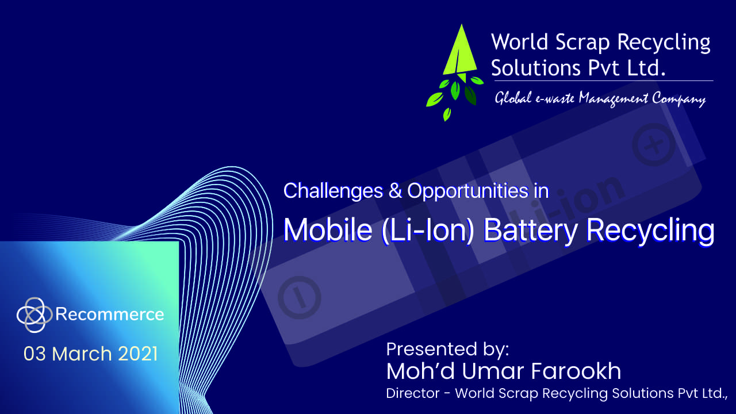

Slide 2
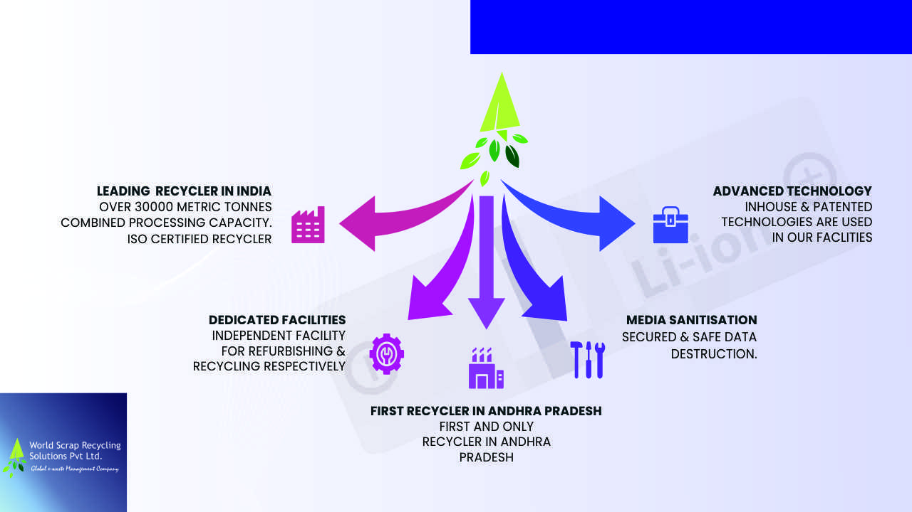
ABOUT US

Slide 3
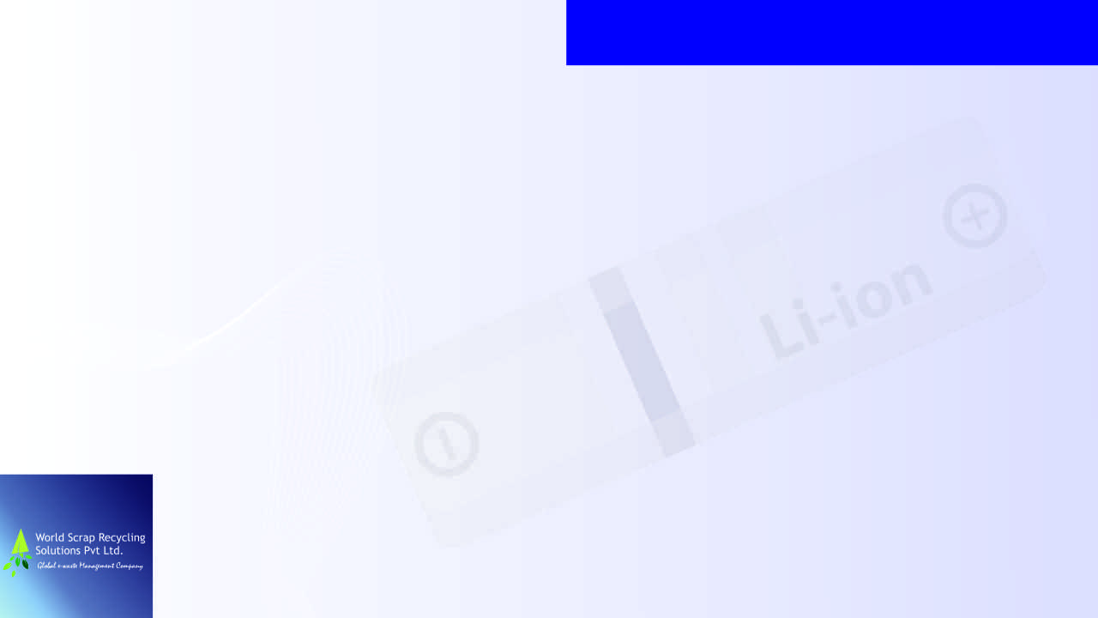
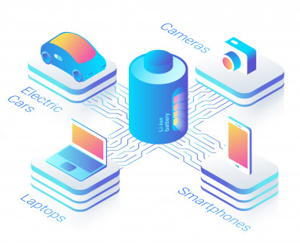
LITHIUM BATTERY SCENARIO
Lithium-ion Battery (LIB) is vital for mobile industry, here mobile denotes a larger prospective – Any electronics which can be taken from point A to point B without the use of connected electricity. How we can move, with the use of batteries and here comes the importance of Lithium Ion Their usage is omnipresent in most rechargeable electronic devices like phones, tablets, laptops, etc.
Contd…,

Slide 4
LITHIUM BATTERY SCENARIO
Primarily dependent on China, Taiwan, and Japan for the import of lithium-cells with only assembling (cell to pack) taking place in India. The government also investing huge on localized manufacture of Lithium-ion-cells, which aims to significantly reduce the cost of electric vehicles (EV) and provide better output in local conditions however due to uncertain geopolitical complexities it becomes harder.
Now here comes the 2 way solution one is procurement of the constituents of the lithium ion other is one of the support solution and that is lithium recycling which offers an effective opportunity to ensure swift disposal and uninterrupted supply of rare battery-grade materials. Recycled LIB can play an important part in support mechanism towards the lithium ion production in India.
Lithium ion waste is an economic opportunity which can be a boon to the lithium production industry if harnessed properly.

Slide 5
LITHIUM BATTERY RECYCLING IN INDIA
As per JMK Research estimates, the lithium-ion battery market in India is expected to increase from 2.9 GWh in 2018 to about 132 GWh by 2030 (CAGR of 35.5%). The increasing volume of lithium-ion batteries would in turn lead to a growing capacity of 'spent' batteries in the ecosystem which if left untreated would lead to health and environmental hazards. JMK research estimates that the recycling market in India will start picking up from the year 2022 onwards when batteries presently in use in electric vehicles would reach their end of life.
Precious metals comprising these batteries would be lost forever. Therefore, managing this lithium-ion battery waste through recycling as already told these recoveries will be a boon to lithium manufacturing.
Contd…,

Slide 6
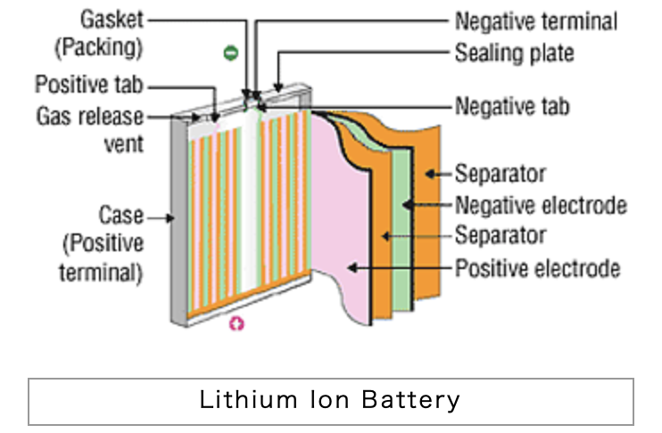
CHALLENGES – RECYCLER PERSPECTIVE
As Told Economic Factors Can Make The Case For Recycling Batteries, They Also Make The Case Against It
BATTERY CHEMISTRY
COMPLICATED CHEMISTRY
BATTERY STRUCTURE
Contd…,

Slide 7
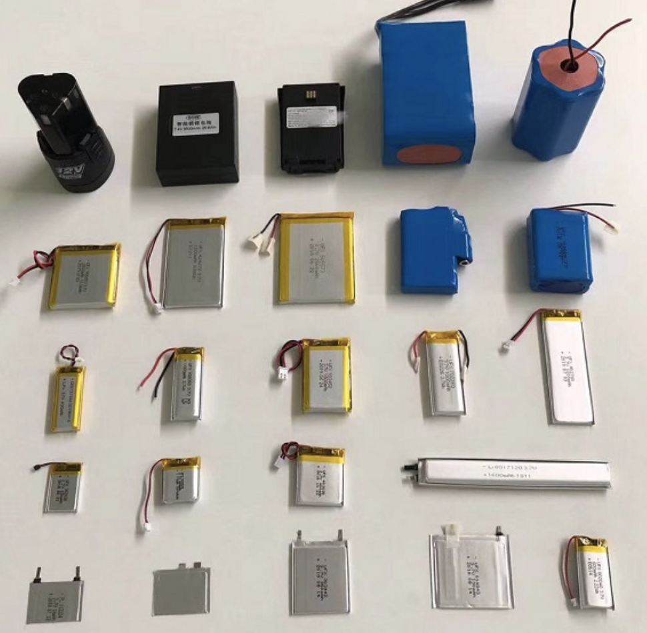
CHALLENGES – RECYCLER PERSPECTIVE
QUALITY & RELIABLE RECYCLING
DOWN CYCLE
TECHNOLOGY RESTRICTION
Contd…,

Slide 8

CHALLENGES – RECYCLER PERSPECTIVE
FINANCIAL ASPECT
RECYCLING COST
MARKET DRIVEN
Contd…,

Slide 9

CHALLENGES – RECYCLER PERSPECTIVE
REGULATIONS
RULES
COMPLIANCE
GUIDELINES
Contd…,

Slide 10
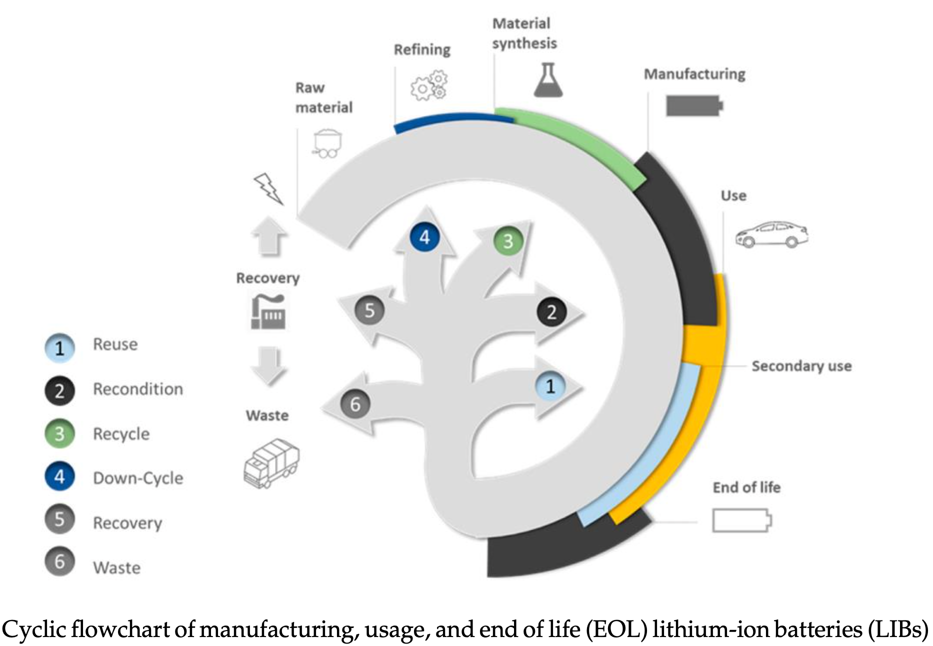
CHALLENGES – RECYCLER PERSPECTIVE

Slide 11
OPPORTUNITIES IN RECYCLING
1
HUGE MARKET & UPCOMING PLAYERS
2
TECHNOLOGY ADVANCEMENT
3
REGULATIONS & GOV. SUPPORT

Slide 12

WAY FORWARD & SUGGESTED REMEDIES
RESEARCH & DEVELOPMENT

Slide 13
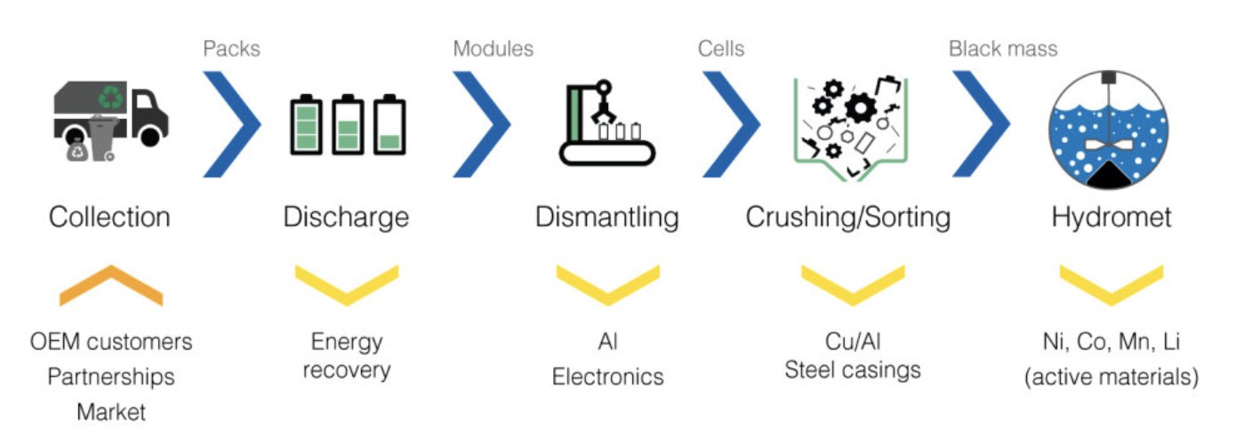
WAY FORWARD & SUGGESTED REMEDIES
PROCESS OPTIMIZATION

Slide 14

WAY FORWARD & SUGGESTED REMEDIES
MORE AWARENESS

Slide 15


